Slide 1
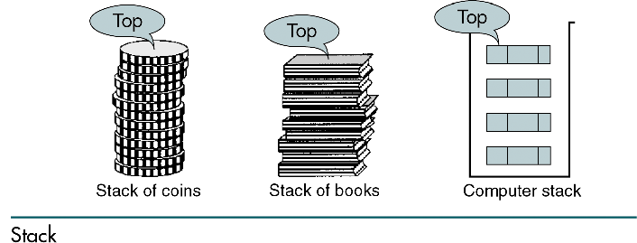
Session -6 STACK IN DATA STRUCTURES

Slide 2
Basic Stack Operations
There are three basic stack operations
Push
Pop
Stack Top

Slide 3
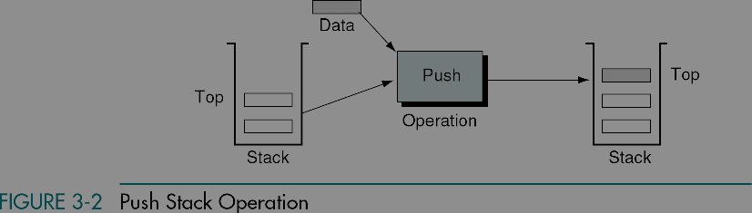

Slide 4
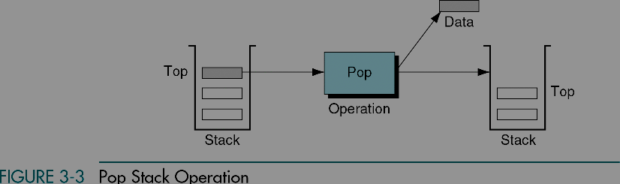

Slide 5
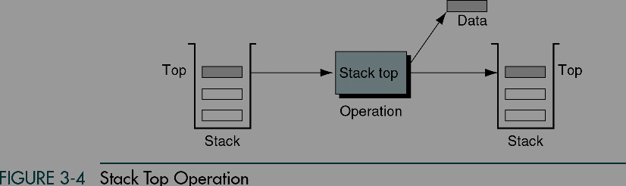

Slide 6
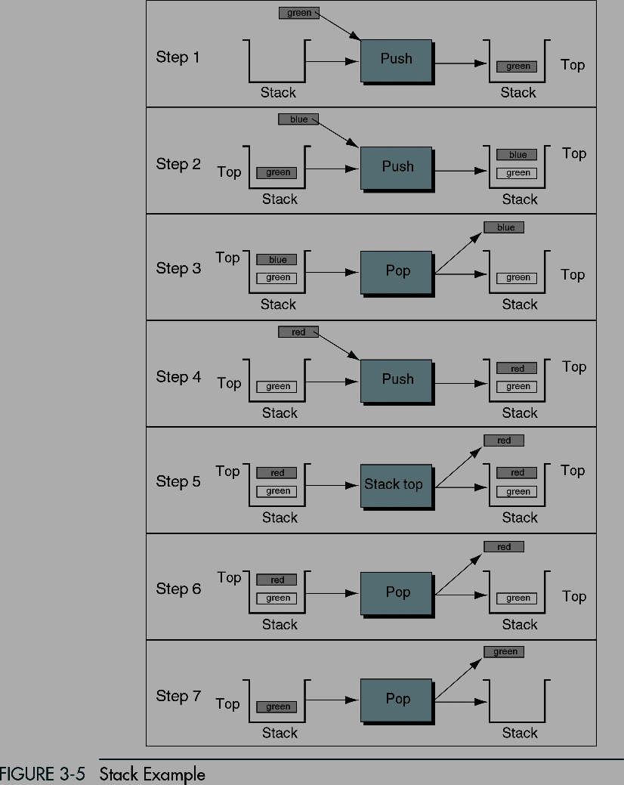

Slide 7
Stack Implementation
#include "ItemType.h"
// Must be provided by the user of the class
// Contains definitions for MAX_ITEMS and ItemType
class StackType {
public:
StackType();
void MakeEmpty();
bool IsEmpty() const;
bool IsFull() const;
void Push(ItemType);
void Pop(ItemType&);
private:
int top;
ItemType items[MAX_ITEMS];
};

Slide 8
Stack Implementation (cont.)
StackType::StackType()
{
top = -1;
}
void StackType::MakeEmpty()
{
top = -1;
}
bool StackType::IsEmpty() const
{
return (top == -1);
}

Slide 9
Stack Implementation (cont.)
bool StackType::IsFull() const
{
return (top == MAX_ITEMS-1);
}
void StackType::Push(ItemType newItem)
{
top++;
items[top] = newItem;
}
void StackType::Pop(ItemType& item)
{
item = items[top];
top--;
}

Slide 10
Stack overflow
The condition resulting from trying to push an element onto a full stack.
if(!stack.IsFull())
stack.Push(item);
Stack underflow
The condition resulting from trying to pop an empty stack.
if(!stack.IsEmpty())
stack.Pop(item);a

Slide 11
Implementing stacks using templates
Templates allow the compiler to generate multiple versions of a class type or a function by allowing parameterized types.
It is similar to passing a parameter to a function (we pass a data type to a class !!)

Slide 12
Implementing stacks using templates
template<class ItemType>
class StackType {
public:
StackType();
void MakeEmpty();
bool IsEmpty() const;
bool IsFull() const;
void Push(ItemType);
void Pop(ItemType&);
private:
int top;
ItemType items[MAX_ITEMS];
};

Slide 13
Example using templates
// Client code
StackType<int> myStack;
StackType<float> yourStack;
StackType<StrType> anotherStack;
myStack.Push(35);
yourStack.Push(584.39);
The compiler generates distinct class types and gives its own internal name to each of the types.

Slide 14
Function templates
The definitions of the member functions must be rewritten as function templates.
template<class ItemType>
StackType<ItemType>::StackType()
{
top = -1;
}
template<class ItemType>
void StackType<ItemType>::MakeEmpty()
{
top = -1;
}

Slide 15
Function templates (cont.)
template<class ItemType>
bool StackType<ItemType>::IsEmpty() const
{
return (top == -1);
}
template<class ItemType>
bool StackType<ItemType>::IsFull() const
{
return (top == MAX_ITEMS-1);
}
template<class ItemType>
void StackType<ItemType>::Push(ItemType newItem)
{
top++;
items[top] = newItem;
}

Slide 16
Function templates (cont.)
template<class ItemType>
void StackType<ItemType>::Pop(ItemType& item)
{
item = items[top];
top--;
}

Slide 17
Comments using templates
The template<class T> designation must precede the class method name in the source code for each template class method.
The word class is required by the syntax of the language and does not mean that the actual parameter must be the name of a class.
Passing a parameter to a template has an effect at compile time.

Slide 18
Implementing stacks using dynamic array allocation
template<class ItemType>
class StackType {
public:
StackType(int);
~StackType();
void MakeEmpty();
bool IsEmpty() const;
bool IsFull() const;
void Push(ItemType);
void Pop(ItemType&);

Slide 19
Implementing stacks using dynamic array allocation(cont.)
template<class ItemType>
StackType<ItemType>::StackType(int max)
{
maxStack = max;
top = -1;
items = new ItemType[max];
}
template<class ItemType>
StackType<ItemType>::~StackType()
{
delete [ ] items;
}

Slide 20
Example: postfix expressions
Postfix notation is another way of writing arithmetic expressions.
In postfix notation, the operator is written after the two operands.
infix: 2+5 postfix: 2 5 +
Expressions are evaluated from left to right.
Precedence rules and parentheses are never needed!!

Slide 21
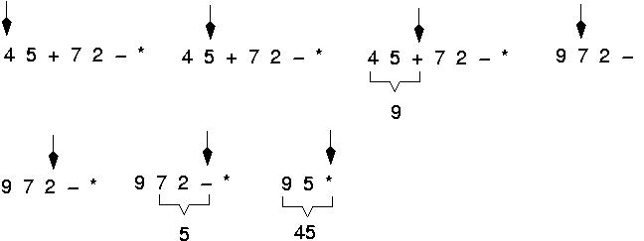
Example: postfix expressions (cont.)

Slide 22
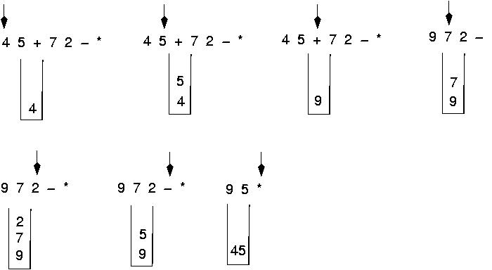
Postfix expressions: Algorithm using stacks (cont.)

Slide 23
Postfix expressions: Algorithm using stacks
WHILE more input items exist
Get an item
IF item is an operand
stack.Push(item)
ELSE
stack.Pop(operand2)
stack.Pop(operand1)
Compute result
stack.Push(result)
stack.Pop(result)

Slide 24
Write the body for a function that replaces each copy of an item in a stack with another item. Use the following specification. (this function is a client program).
ReplaceItem(StackType& stack, ItemType oldItem, ItemType newItem)
Function: Replaces all occurrences of oldItem with newItem.
Precondition: stack has been initialized.
Postconditions: Each occurrence of oldItem in stack has been replaced by newItem.
(You may use any of the member functions of the StackType, but you may not assume any knowledge of how the stack is implemented).

Slide 25
{
ItemType item;
StackType tempStack;
while (!Stack.IsEmpty()) {
Stack.Pop(item);
if (item==oldItem)
tempStack.Push(newItem);
else
tempStack.Push(item);
}
while (!tempStack.IsEmpty()) {
tempStack.Pop(item);
Stack.Push(item);
}
}
Stack
tempStack
3
1
2
5
1
3
Stack
3
oldItem = 2
newItem = 5
5
1

Slide 26
OUTPUT
1, 3-7, 14, 12, 15, 18, 19

Slide 27
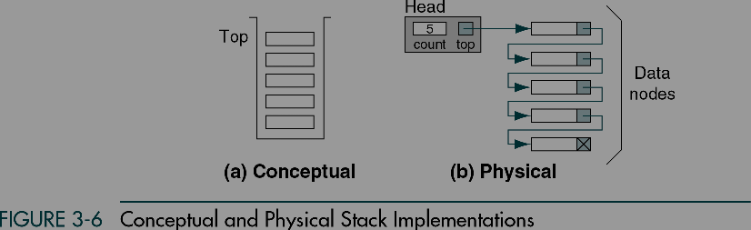
Stack Linked List Implementation

Slide 28
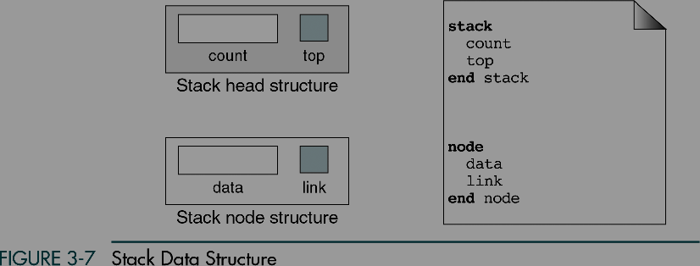

Slide 29
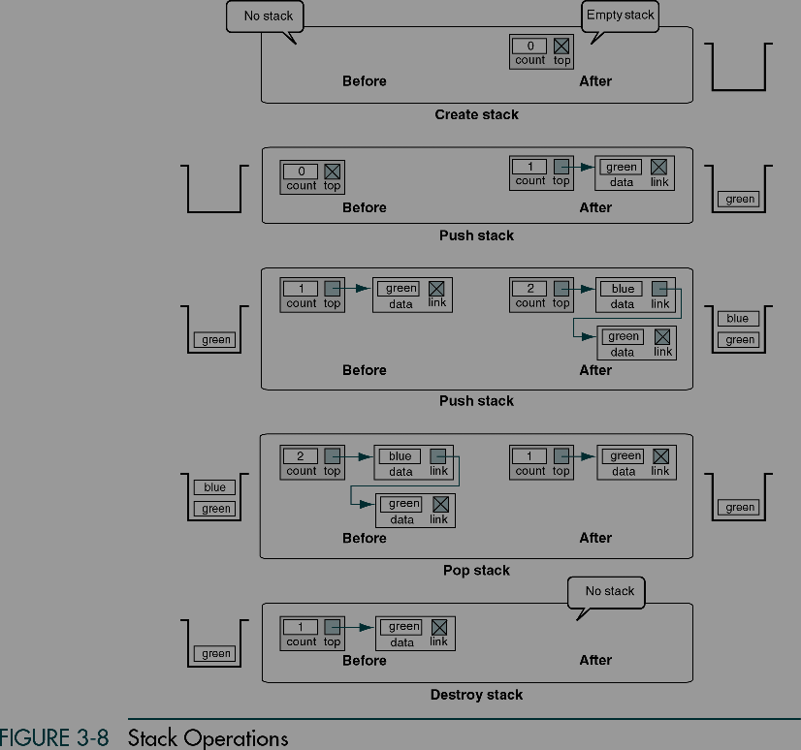

Slide 30
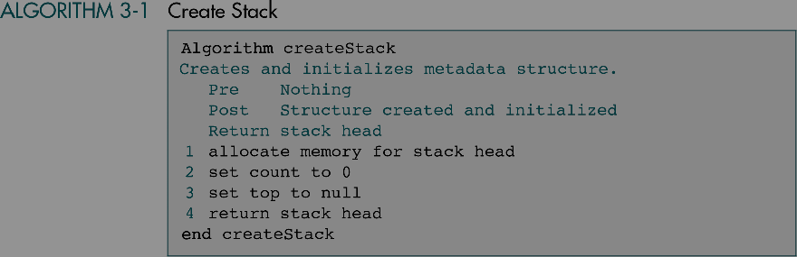

Slide 31
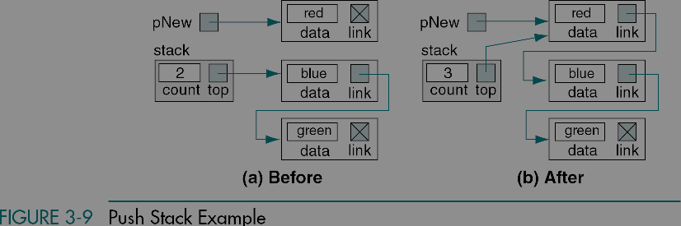

Slide 32
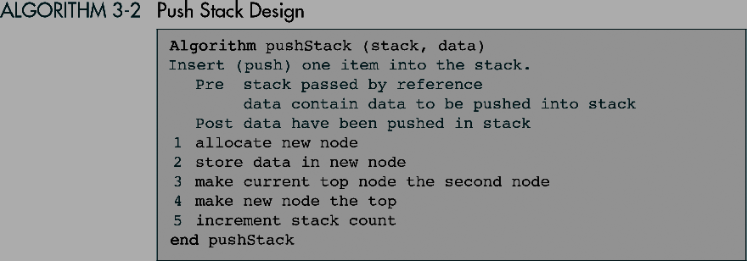

Slide 33
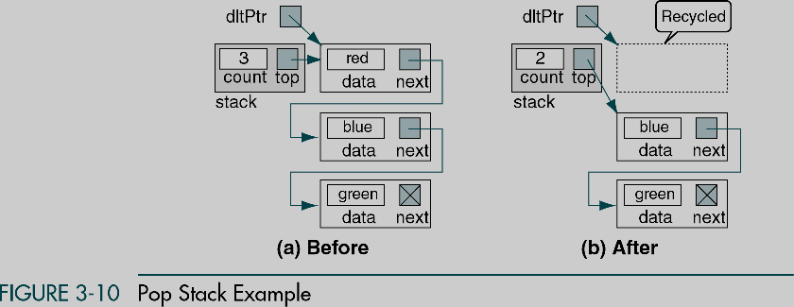

Slide 34
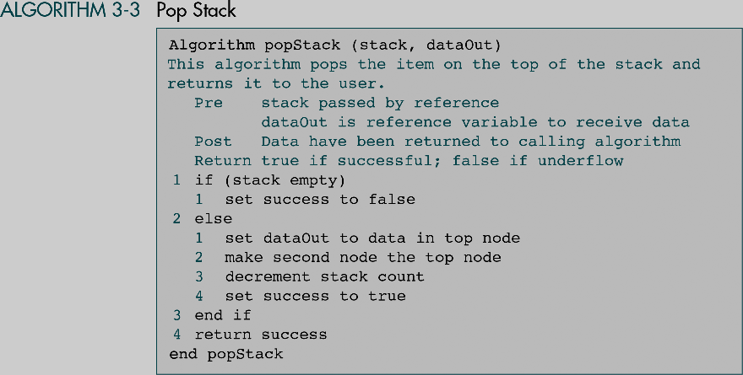

Slide 35
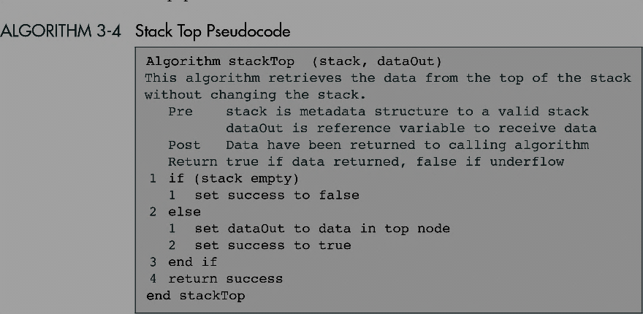

Slide 36
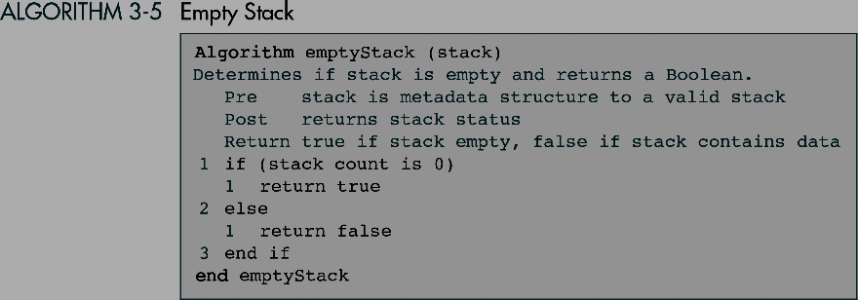

Slide 37
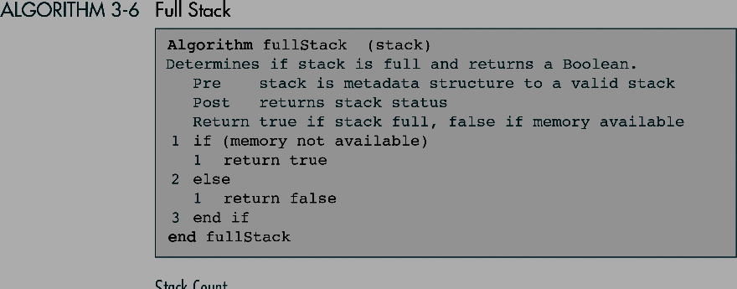

Slide 38
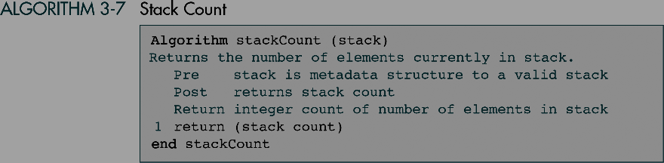

Slide 39
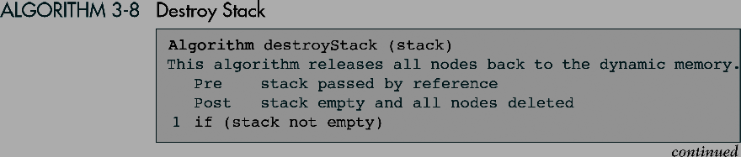
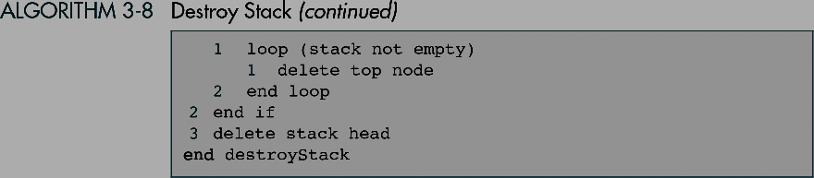

Slide 40
C Language Implementations
This section presents a simple non-ADT implementation of a stack. We develop a simple program that inserts random characters into the stack and then prints them.

Slide 41
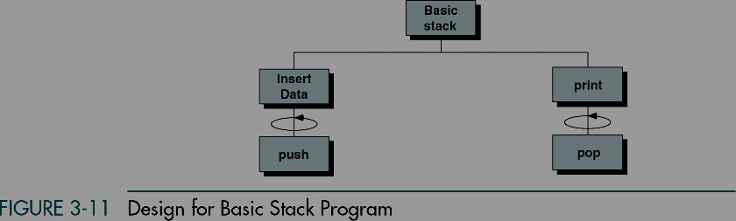

Slide 42
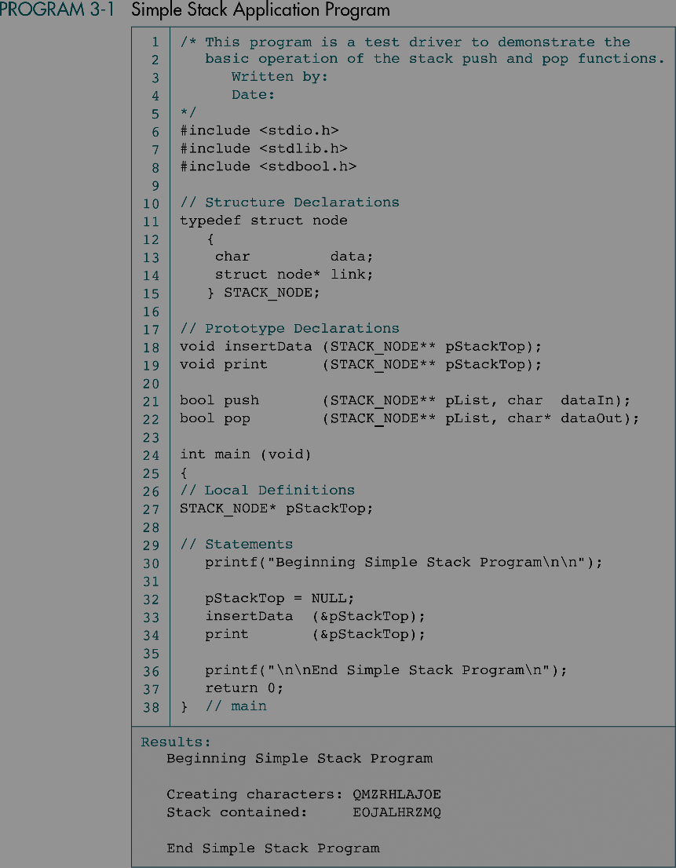

Slide 43
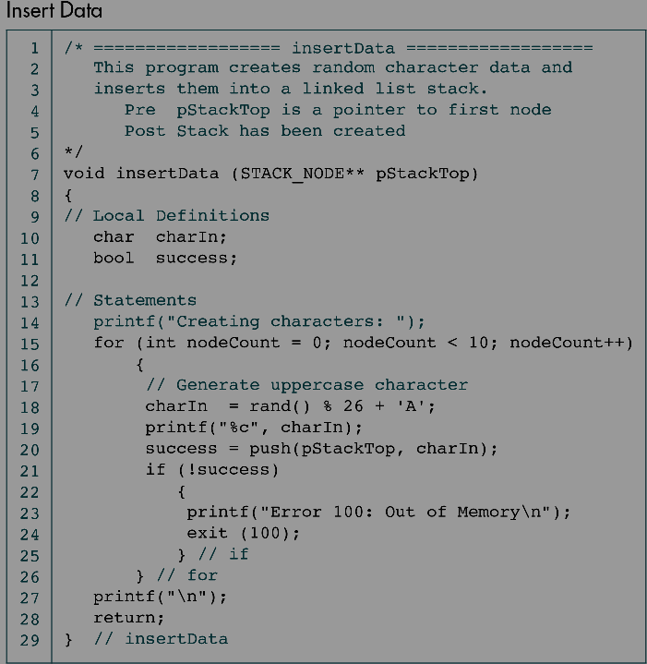

Slide 44
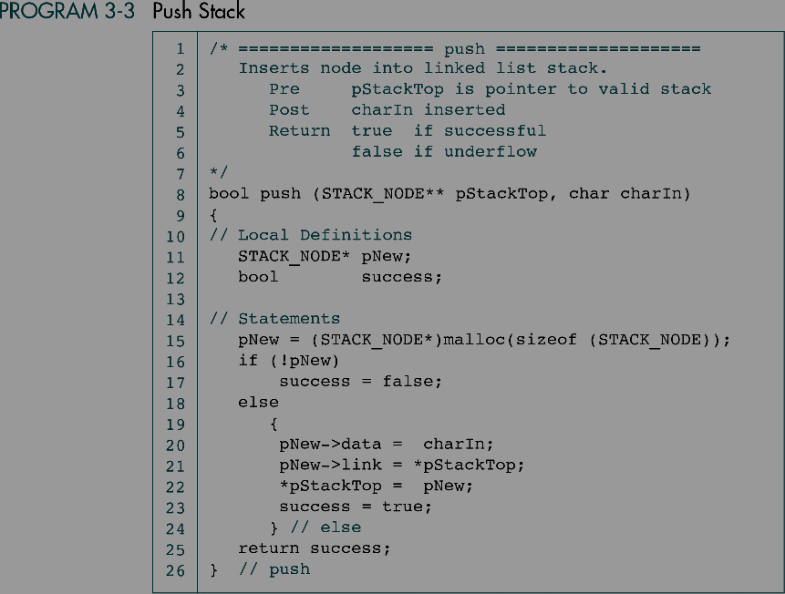
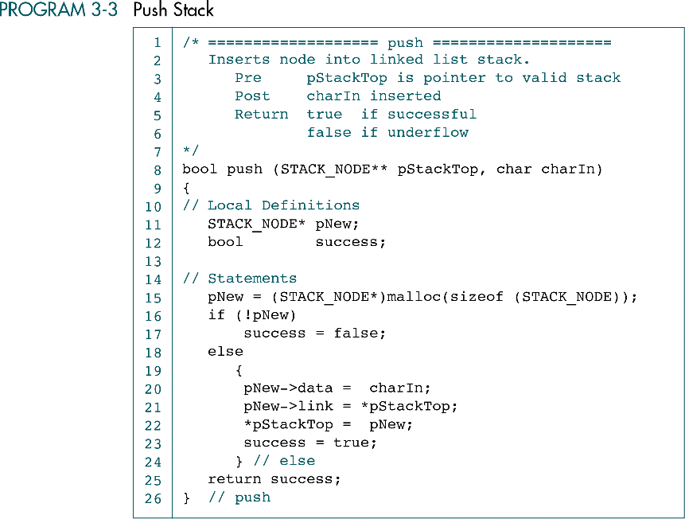

Slide 45
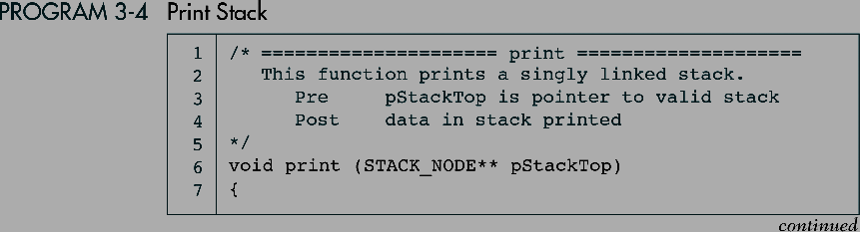
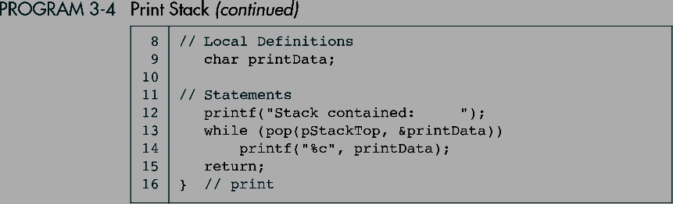

Slide 46
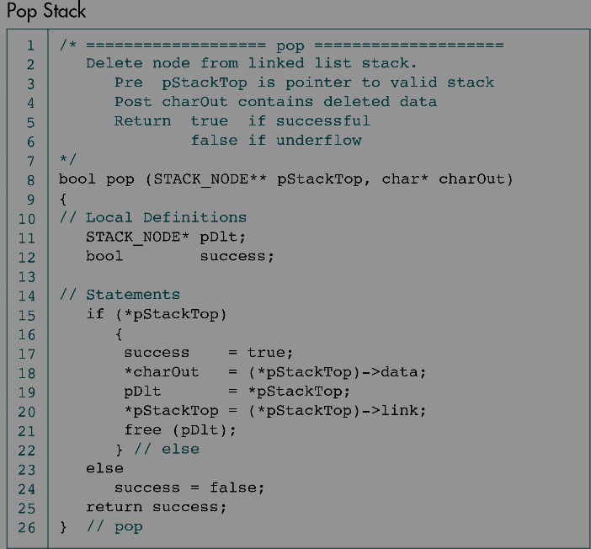

Slide 47
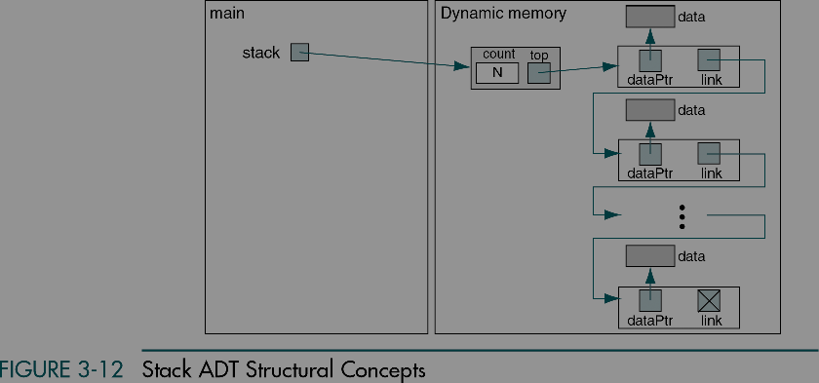
Stack ADT

Slide 48
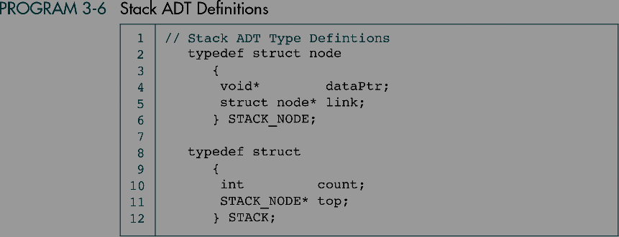

Slide 49
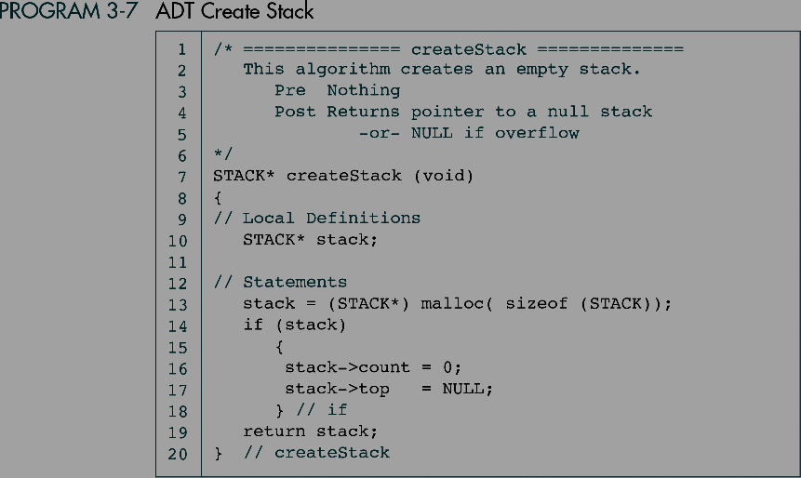

Slide 50
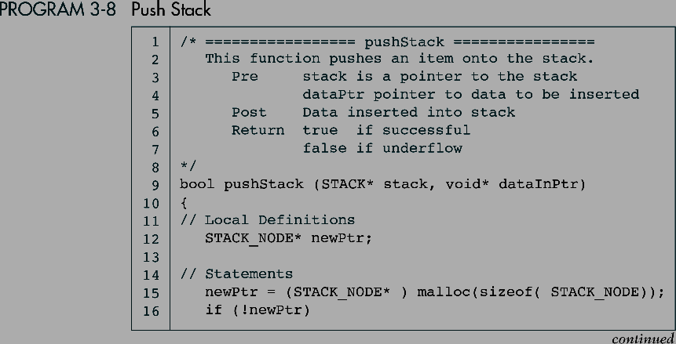
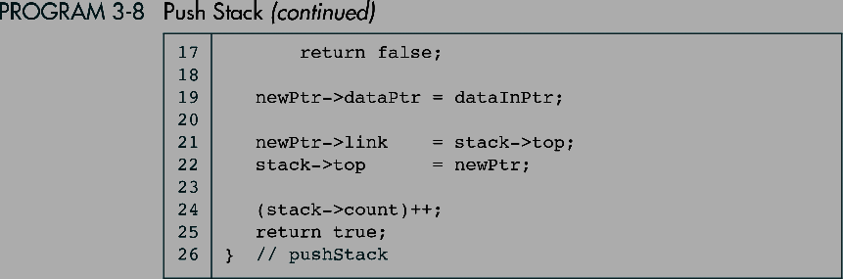

Slide 51
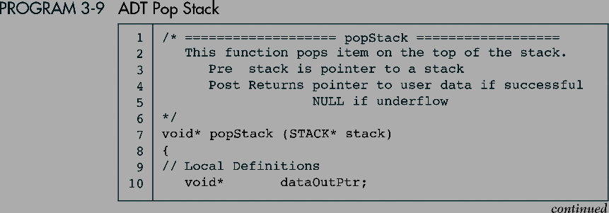

Slide 52
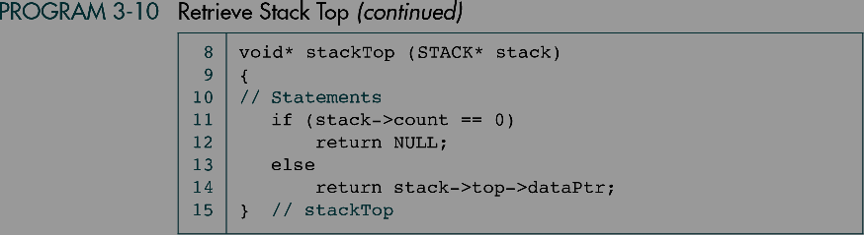

Slide 53
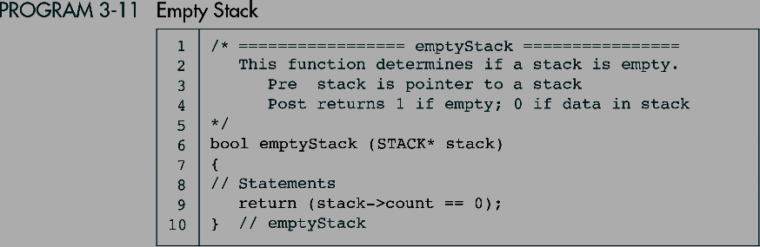

Slide 54
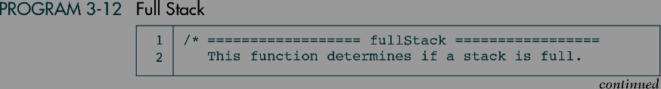
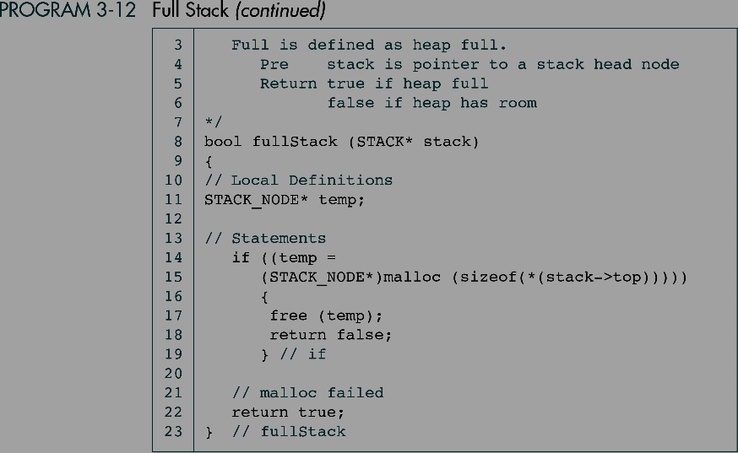

Slide 55
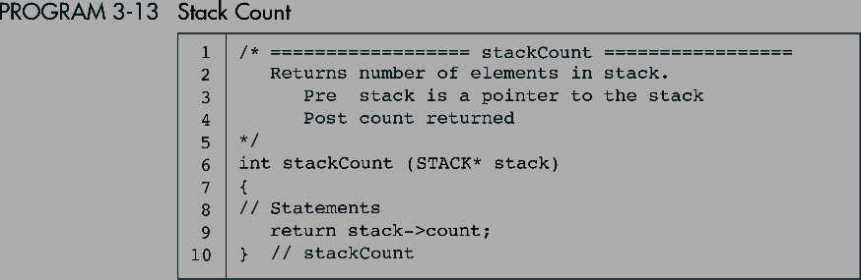

Slide 56
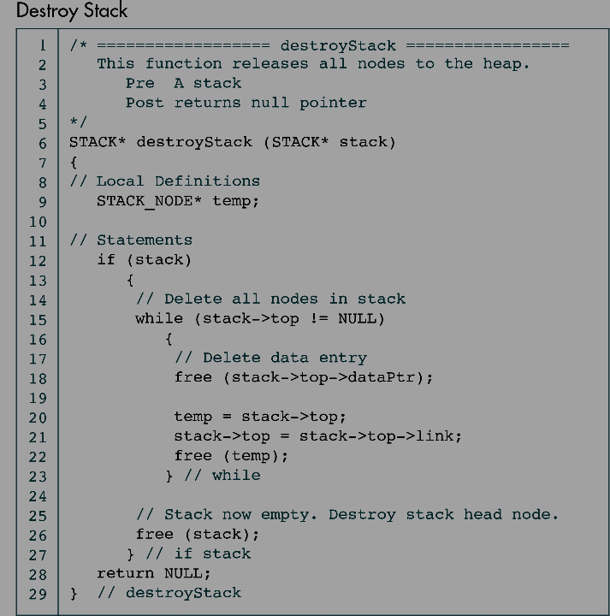

Slide 57
End of Session – 6
Thank You…

